Slide 1
Introduction to NLTK & Building a Spell Checker
Notes:
This lecture is an introduction to the Natural Language Toolkit followed by a tutorial on how to build a spell checking system. We estimate that this entire tutorial may take around 1.5 hours, so feel free to split it into a few meetings as well. This lecture was created by Karina Halevy and Leo Lin.

Slide 2
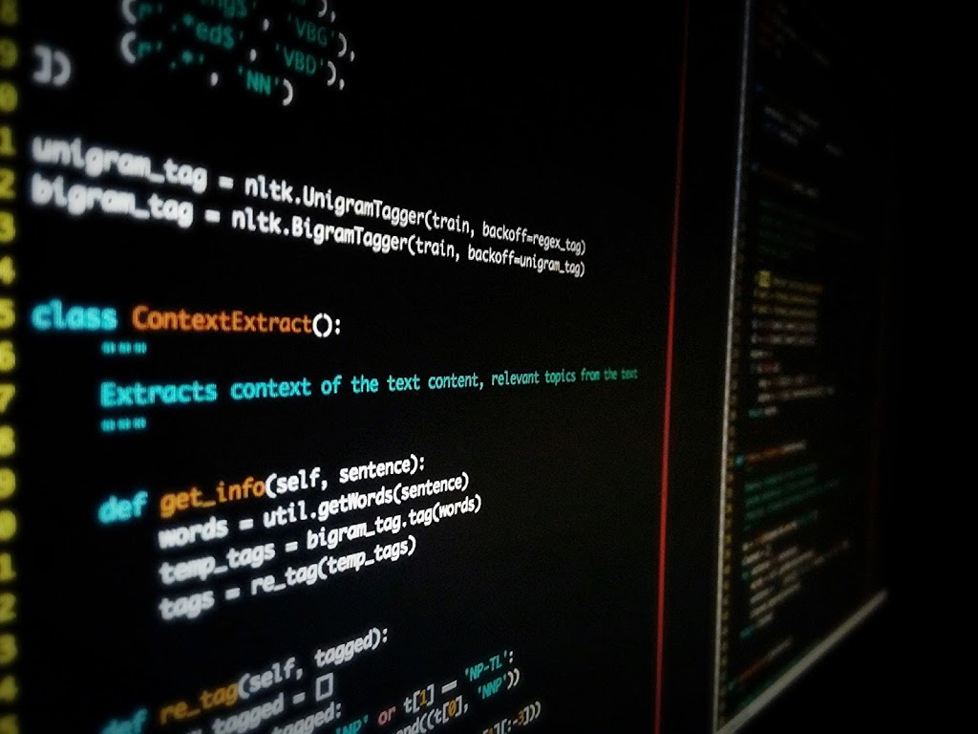
OVERVIEW
NLTK: Natural Language Toolkit
Python Library
Natural Language Analysis
Text Processing Tools
Large Corpora for NLP Training
Read: D A T A
Examples: gutenberg, brown, inaugural, reuters, webtext, nps_chat
https://www.nltk.org
Notes:
NLTK, or the Natural Language Toolkit, is a Python module or library that has built-in functions that can analyze natural language. So instead of having to write a lot of things from scratch, we can just use or “call” these pre-written functions. In addition to being able to analyze text data, NLTK also has some natural language datasets, which are datasets full of text, that we can train machine learning systems on. One example of a dataset is the Gutenberg dataset, which is a sample of some of the ebooks collected by Project Gutenberg. Project Gutenberg is an initiative that archives and preserves pieces of literature as e-books, and so the NLTK Gutenberg dataset takes several of these ebooks and saves each one as a text file with all its raw text. The Gutenberg dataset is a really good dataset when we’re dealing with problems that are related to formal language because the samples inside this dataset are of formal and established literature.

Slide 3
WHAT WE NEED
https://repl.it/languages/python3
Follow along: https://tinyurl.com/linghacks-workshop-1
spell-check folder
import nltk nltk.download('gutenberg') nltk.download('punkt')
Notes:
So now we’re going to explore some of the data that NLTK has to offer. For this part, you should probably start a new repl on repl.it (just type in repl.it/languages/python3), and we’re going to write the following three lines. The first line, import nltk, is the Python way of saying we’re going to use functions from the nltk package in our program, so we need to be able to call it. And by importing a package, we can now call its functions using the package name. One of these functions is the .download function, which we’ll need to use to “download” our gutenberg dataset as well as this package called “punkt,” which contains some word processing functions that we’ll use later in this workshop. These are all just Python things, so there isn’t really “math” or “logic” to understand behind them, it’s just a thing we have to do to get all these packages and their functions loaded into our program. Everybody good?

Slide 4
EXPLORING OUR DATA
from nltk.corpus import gutenberg gutenberg.fileids()
Notes:
Now that we have our packages imported and downloaded, we’re going to take a closer look at the Gutenberg dataset. So type all of this on your same repl. So first, here’s a trick to make life easier (aka save a lot of typing). In Python, a lot of modules or packages have subpackages that can be called by [main package].[subpackage], as in nltk.corpus here. So the corpus subpackage within NLTK contains all the corpuses, or sets, of data that’s built into NLTK that we can use to train our programs. Within the subpackage corpus, we want to specifically import “gutenberg,” which is the gutenberg corpus. So now, instead of having to say nltk.corpus.gutenberg or referencing the entire package-subpackage sequences whenever you want to call gutenberg, we can just say gutenberg.blah, and it’ll work. And yes, because this is Python, we had to .download “gutenberg” and then import it to get it in the program. Put that first import statement right below where you typed “import nltk,” because Python makes you put all your imports up front up top. Now, we’re going to call this fileids() function. As I mentioned before, the gutenberg database is a collection of txt files of ebooks uploaded by Project Gutenberg. So the fileids() function is going to return a list of the names of these txt files that comprise this Gutenberg corpus.

Slide 5
OUTPUT
['austen-emma.txt', 'austen-persuasion.txt', 'austen-sense.txt', 'bible-kjv.txt', 'blake-poems.txt', 'bryant-stories.txt', 'burgess-busterbrown.txt', 'carroll-alice.txt', 'chesterton-ball.txt', 'chesterton-brown.txt', 'chesterton-thursday.txt', 'edgeworth-parents.txt', 'melville-moby_dick.txt', 'milton-paradise.txt', 'shakespeare-caesar.txt', 'shakespeare-hamlet.txt', 'shakespeare-macbeth.txt', 'whitman-leaves.txt']
Notes:
So hopefully, you guys should run it and get this output. *pause for questions & ask if anyone is not seeing this or getting an error or something* So we can see that we have a list of filenames which are named by author dash book title. For example, Gutenberg contains Persuasion by Jane Austen, Hamlet by Shakespeare, and Alice in Wonderland by Lewis Carroll. Questions?

Slide 6
MORE DATA EXPLORATION
for fileid in gutenberg.fileids(): num_chars = len(gutenberg.raw(fileid)) num_words = len(gutenberg.words(fileid)) num_sents = len(gutenberg.sents(fileid)) num_vocab = len(set(w.lower() for w in gutenberg.words(fileid))) print(round(num_chars/num_words), round(num_words/num_sents), round(num_words/num_vocab), fileid)
Notes:
Ok! Now that we know what books we have in our Gutenberg corpus, let’s get some more information. We’re still on the same repl, so just press enter after the last function you typed and start typing this. So using a for loop looping through each id in the fileids (which is each filename in the list of filenames, or each book in the list of book names), we’re going to get four pieces of information. The first is num_chars, which is the number of characters--so letters, spaces, numbers, punctuation, each of those counts as a character--in the raw file’s text. Breaking this down: gutenberg.raw is the function that just retrieves the raw text from a file in Gutenberg. Inside the raw function, we pass in this fileid parameter, which is the name of our txt file or book, as a way for the function to reference the file we’re looking at and get information from it. And len(), as you recall, is the length of this raw text, and it will treat the text file as a string and just count up the number of characters. Make sense?
Our second piece of information is num_words. Again, using our fileid, we’re going to call gutenberg.words this time, which is a function that returns a list of the words in a text file in order. So for example, if our text file said “I like cheese,” it would return a list where the first item is “I”, the second item is “like”, and the third item is “cheese”. And so len calculates the length of this list, which is the number of words that we have in the file or book.
Next, we’re going to get the number of sentences in the file. This is the same thing as words and chars, just calling the sents function, which returns a list of the sentences in the corpus, instead of words or raw.
Lastly, we’re going to get this number called num_vocab, and this is basically the number of unique words, or “vocabulary words”, in the corpus. So for example, if our file said “I like me and they like me,” gutenberg.words would return a list that goes [I, like, me, and, they, like, me], but num_vocab would only return [I, like, me, and, they], so eliminating the duplicate words. Now breaking down the code: we know what gutenberg.words(fileid) does, and now we’re saying that we want a set, which is a “list” of all the unique elements, of all the words “w” for “w” in the gutenberg.words. One thing to point out here is that we convert every word to lowercase using this w.lower() function, so that saying The at the beginning of a sentence with a capital “t” doesn’t count as a different word than saying “the” with no caps in the middle of a sentence. And again, we take the len of this to see how many unique words there are. Any questions about this?
Now finally, we want to print some of this data. The first thing we’re printing is num_chars/num_words, which is the average number of letters per word. Does everyone see why that is? Ok. And because we can’t have like, 5.2 letters in a word, we put this number inside a round() function, which just rounds it down to the nearest whole number. The next thing we want to see is num_words/num_sents, which is the average number of words in each sentence in the file. Again we round this. Next, we want to know num_words/num_vocab, which gives you the average number of times each word is used in the file. Does everyone see why? Any questions? Ok. And finally, we print the fileid just so we can see which file we’re looking at. Ok, so let’s run it!

Slide 7
OUTPUT
5 25 26 austen-emma.txt 5 26 17 austen-persuasion.txt 5 28 22 austen-sense.txt 4 34 79 bible-kjv.txt 5 19 5 blake-poems.txt 4 19 14 bryant-stories.txt 4 18 12 burgess-busterbrown.txt 4 20 13 carroll-alice.txt 5 20 12 chesterton-ball.txt 5 23 11 chesterton-brown.txt 5 18 11 chesterton-thursday.txt 4 21 25 edgeworth-parents.txt 5 26 15 melville-moby_dick.txt 5 52 11 milton-paradise.txt 4 12 9 shakespeare-caesar.txt 4 12 8 shakespeare-hamlet.txt 4 12 7 shakespeare-macbeth.txt 5 36 12 whitman-leaves.txt
Notes:
Ok, hopefully you ran it and got this output. *pause if people have problems or questions* As we see for example, Persuasion by Jane Austen has about five letters per average word, 26 words per sentence, and each word occurs about 17 times on average. Does this make sense for everyone? Are there any questions?

Slide 8
THE ACTUAL TEXT
print(gutenberg.raw('austen-persuasion.txt'))
[Persuasion by Jane Austen 1818] Chapter 1 Sir Walter Elliot, of Kellynch Hall, in Somersetshire, was a man who, for his own amusement, never took up any book but the Baronetage; there he found occupation for an idle hour, and consolation in a distressed one; there his faculties were roused into admiration and respect, by contemplating the limited remnant of the earliest patents; there any unwelcome sensations, arising from domestic affairs changed naturally into pity and contempt as he turned over the almost endless creations of the last century; and there, if every other leaf were powerless, he could read his own history with an interest which never failed. This was the page at which the favourite volume always opened: "ELLIOT OF KELLYNCH HALL. "Walter Elliot, born March 1, 1760, married, July 15, 1784, Elizabeth, daughter of James Stevenson, Esq. of South Park, in the county of Gloucester, by which lady (who died 1800) he has issue Elizabeth, born June 1, 1785; Anne, born August 9, 1787; a still-born son, November 5, 1789; Mary, born November 20, 1791." ...
Notes:
Now that you’ve seen some statistics about the text, we should probably take a look at what the actual heck is in these texts. So let’s print out the raw text of Persuasion by Jane Austen using this command gutenberg.raw, passing in “austen-persuasion.txt” as our fileid. You guys should get something like this, which is basically just plain text from her book. *pause for questions and errors*

Slide 9
Spell Check
Notes:
Perhaps pause and transition to spell check (a specific application of NLTK)

Slide 10
SPELL CHECK PIPELINE
Load training data
Tokenize the corpus
Develop a probabilistic model to find:
The possible correct words
The one that’s most probably correct
Make it look nice
Notes:
So here’s an overview of how a spell check system would work. First, you need some sort of database of the language you’re spell-checking in, so if you’re spell-checking things in English, you need a reference database of English words that you can possibly correct to. Then, you want to tokenize the corpus, which is basically splitting the corpus, or dataset, into all the words it contains. Using the tokenized form of the corpus, you can then use some sort of algorithm or probabilistic model to see what words are in the universe that you can correct to and which of those words is the most likely correct option. And then you have to write code that obviously looks nice and can be used easily. :)

Slide 11
LOADING DATA
from collections import Counter from nltk.corpus import gutenberg from nltk.tokenize import word_tokenize as tokenizer corpus = [] for txt in gutenberg.fileids(): raw_text = gutenberg.raw(txt) tokenized_text = tokenizer(raw_text) corpus.extend(tokenized_text) word_corpus = Counter(corpus) print(word_corpus)
Notes:
Basically explain every line of code - first import the necessary packages, then start an empty list which you’ll fill up with the corpus, and then loop through the gutenberg text and add all the words to the corpus (say that you’re using word_tokenize so the function splits every piece of text into its component words)
Cast the corpus as a Counter, which basically takes a list and turns it into a dictionary, where the keys are the elements of the list and the values are the number of times they occur

Slide 12
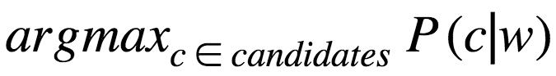
ALGORITHM: HIGH-LEVEL SNAPSHOT
w: “features” - spelling of the wrong word
c: “class” - potential correct word
candidates: set of all possible correct words or “classes”
∈: mathematical symbol for “is an element of a set”
argmax: maximum probability of all candidate classes
P(c|w): probability that you meant c given the spelling w
Function correction(w):
Notes:
Basically explain what’s on the slide
Explanation of correction(w): out of all of the candidate words (words similar enough to the misspelled word), pick the one that has the greatest probability of the user meaning that word given that it was misspelled the way it was misspelled

Slide 13
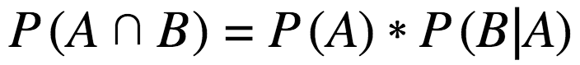
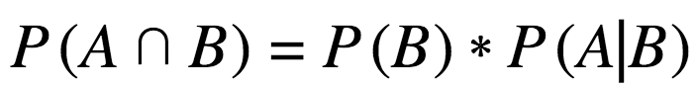
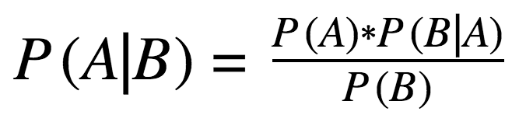
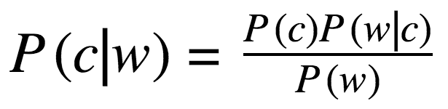
MATH: BAYES’ RULE
Notes:
Bayes’ Rule is an important rule in probability. Explanation:
First formula: P(A “intersection” B) is the probability that A and B both happen, and that’s equal to the probability that A happens, times the probability that B happens given that A happened
Second formula: same thing, but we can say it’s the probability that B happens, times the probability that A happens given that B happened
Now, we have P(A) * P(B|A) = P(B) * P(A|B), which we can then manipulate to get the third formula, which is the statement of Bayes’ Rule
Applying it to our candidate words c and our misspelled word w, we have the formula in the red box
In English, this says that the probability that we meant c given that we spelled w is the probability that we would ever mean the word c (some sort of measure of frequency of the word c in the English language), times the probability that we would misspell c as w (aka probability that we would write w if we meant c), divided by the probability that we would ever mean the word w
More explanations on next slide

Slide 14
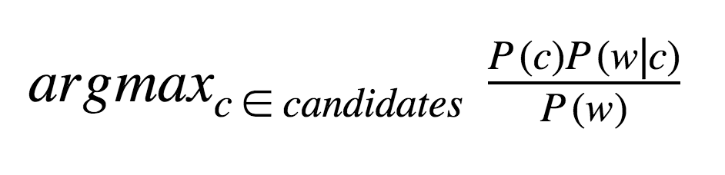
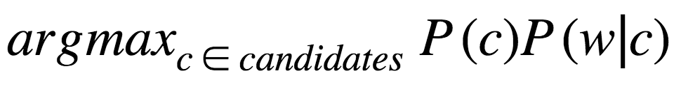
TRANSFORMED EXPRESSION
P(w): probability that the wrong word w is spelled as such
Doesn’t depend on c!
Factor out
Notes:
It turns out that this expression can be simplified! P(w) is the probability that we would ever write w in the universe of all words, but that doesn’t depend on the candidate c! Since we are just interested in comparing the values among the different candidates, we can factor out P(w) as a constant, so all we need to find is the candidate with the max value of P(c)P(w|c)
More explanations on next slide

Slide 15
MODELS
P(c): probability that c occurs as a word of English text
Frequency in the corpus/total number of words in the corpus
Language model
P(w|c): probability that given that you meant c, you spelled it as w
Error model
Naïve error model: lower edit distance = higher error probability
Notes:
How to calculate P(c): we “approximate” the language using a corpus of words/sentences in the language, in this case the Gutenberg dataset; then, we take the number of times c appears in the text divided by the total number of words in the text
This is often called the language model because it’s a model (kind of like an approximation) for how the word functions in the context of the language
How to calculate P(w|c): this is called the error model because it’s measuring the likelihood that you would make a particular error
We’re going to calculate this naively by using an edit distance metric, which is basically how many letters need to be modified to get from c to w. We’re going to make the very simplistic assumption that the fewer letters you need to modify/add/delete to get from c to w, the greater the probability that you meant c; furthermore, if two words have the same edit distance, they’ll have the same P(w|c)

Slide 16
LANGUAGE MODEL: CODE
def prob(word, N=sum(word_corpus.values())): return word_corpus[word] / N
Notes:
Here’s the code for the language model: we basically define a function called prob, and it takes in a candidate word as well as a number N representing the total number of words in the corpus, which we’ve previously loaded as a Counter
All we have to do is retrieve the number of occurrences of word by referencing word_corpus, and then divide it by N

Slide 17
GENERATING CANDIDATES
def edits1(word): letters = 'abcdefghijklmnopqrstuvwxyz'
Notes:
Now, we’re going to implement our error model in a few steps, basically by generating possible candidates. We’re going to start by defining a function edits1(word), which will return a list of variations of that word where only one letter has been changed, deleted, or added. To start off, let’s create a variable letters that stores all the lowercase letters in the English alphabet.

Slide 18
SPLITS
Splitting each word into two words
Not actually going to be used, just a helpful function
Walk through each letter in the word, return a tuple that splits it at that point
Example: “swaw” → [(, “swaw”), (“s”, “waw”), (“sw”, “aw”), (“swa”, “w”), (“swaw”,)]
def edits1(word): letters = 'abcdefghijklmnopqrstuvwxyz' splits = [(word[:i], word[i:]) for i in range(len(word) + 1)]
Notes:
Before we get into actual edits, we’re going to generate a helpful set of words called splits - which is splitting a word into two words (walk through the example above). The way we generate all the splits is that we slice our string word at every possible point.

Slide 19
DELETES
Typed an extra character
Loops through each letter and returns the word without that letter
Example: “swaw”: [“waw”, “saw”, “sww”, “swa”]
def edits1(word): """All edits that are one edit away from `word`.""" letters = 'abcdefghijklmnopqrstuvwxyz' splits = [(word[:i], word[i:]) for i in range(len(word) + 1)] deletes = [L + R[1:] for L, R in splits if R]
Notes:
The first type of edit is the delete, which is where w contains an extra character. We basically delete every possible character within the word, and we do this with the help of splits, which is a list of every possible partition of the word! Basically, for each split, we’ll want the left side of the split plus the right side, but for the right side, we’ll only want everything *after* the first character (hence the [1:]). Furthermore, we don’t want the whole word, and the way we check for that is with the “if R” - if L is the whole word, then R will be empty.

Slide 20
TRANSPOSES
Rearranged letters
Loops through each character and swaps that character with another character in the word
Example: “swaw”: “wsaw”, “saww”, “swwa”
def edits1(word): """All edits that are one edit away from `word`.""" letters = 'abcdefghijklmnopqrstuvwxyz' splits = [(word[:i], word[i:]) for i in range(len(word) + 1)] deletes = [L + R[1:] for L, R in splits if R] transposes = [L + R[1] + R[0] + R[2:] for L, R in splits if len(R)>1]
Notes:
The second type of edit is the transpose, which is where two letters that are next to each other get swapped. To generate these, we’ll again make use of our splits. Essentially, for each split, all we have to do is swap the first and second characters of the right side of the split, with the condition that there must be at least two characters on the right side of the split.

Slide 21
REPLACES
Mistyped a character
Loops through each character and exchanges it with each character in the alphabet
Example: “swaw”: “awaw”, “bwaw”, “cwaw”, … , “saaw”, “sbaw”, “scaw”, ...
def edits1(word): letters = 'abcdefghijklmnopqrstuvwxyz' splits = [(word[:i], word[i:]) for i in range(len(word) + 1)] deletes = [L + R[1:] for L, R in splits if R] transposes = [L + R[1] + R[0] + R[2:] for L, R in splits if len(R)>1] replaces = [L + c + R[1:] for L, R in splits if R for c in letters if c != R[0]]
Notes:
The third type of edit is the replace, where you mistyped one character. For this, we will make use of splits again, as well as our alphabet letters. Basically, we’ll do something similar to deletes, except instead of getting rid of the middle character in each split, we’ll replace it with another character that’s not the original character - and we’ll replace with every possible character in the alphabet that we can replace with.

Slide 22
INSERTS
Skipped a letter
Loops through each character and inserts a character in the alphabet
Example: “swaw”: “aswaw”, “bswaw”, … , “sawaw”, “sbwaw”, etc.
def edits1(word): letters = 'abcdefghijklmnopqrstuvwxyz' splits = [(word[:i], word[i:]) for i in range(len(word) + 1)] deletes = [L + R[1:] for L, R in splits if R] transposes = [L + R[1] + R[0] + R[2:] for L, R in splits if len(R)>1] replaces = [L + c + R[1:] for L, R in splits if R for c in letters] inserts = [L + c + R for L, R in splits for c in letters]
Notes:
Lastly, we have inserts! This is where we accidentally skipped a letter in our misspelling, so to generate the inserts, we’re going to again use the splits. But this time, we’ll want the entire split, and we’ll just interject with every possible character in between.

Slide 23
RETURN
def edits1(word): letters = 'abcdefghijklmnopqrstuvwxyz' splits = [(word[:i], word[i:]) for i in range(len(word) + 1)] deletes = [L + R[1:] for L, R in splits if R] transposes = [L + R[1] + R[0] + R[2:] for L, R in splits if len(R)>1] replaces = [L + c + R[1:] for L, R in splits if R for c in letters] inserts = [L + c + R for L, R in splits for c in letters] return set(deletes + transposes + replaces + inserts)
Notes:
So that’s our universe of words with edit distance 1! The last thing we’ll do is just return all of them! To do this, we concatenate the lists of deletes, transposes, replaces, and inserts into one big list, and then we cast it as a set (recall that a set gets rid of duplicates).

Slide 24
EDIT DISTANCE 2
def edits2(word): return [e2 for e1 in edits1(word) for e2 in edits1(e1)]
Notes:
Next, we’re going to generate the words with edit distance 2. To do this, we just take all the words with edit distance 1 and edit them by another 1!

Slide 25
EDITS MUST BE ENGLISH WORDS!
def known(words): return set(w for w in words if w in word_corpus) def candidates(word): return known([word]) or known(edits1(word)) or known(edits2(word)) or [word]
Notes:
Now that we have all of our candidates, we’re going to narrow them down. As a first step, all of our candidates need to be English words. As an approximation for this, we’re going to say that a candidate is an English word if it’s in the word corpus - so that’s what the known function does.
After that, we’re going to get the candidates of a word - essentially what this line does is that if the word itself is a known English word, then we’re going to assume that it wasn’t misspelled, and we’re going to just return that word. If, however, that word isn’t an English word, then known([word]) is going to come up empty, in which case we move to the words with edit distance 1. Then, if none of those words are known, we move to edit distance 2. Finally, if all else fails, that probably means we’ve misspelled the word so badly that it might as well be a new made up word, so we’ll just return that word.

Slide 26
PICK THE ONE!
def correction(word): return max(candidates(word), key=prob)
Notes:
The last step is to actually generate the correction! Essentially, once we’ve generated our candidates, we know that they all have equal values of P(w|c), since we only return the words with one specific edit distance. So then, we calculate the prob (P(c)) for each candidate, and we return the word with the max value. This max(blah, key) syntax basically says return the max of the first argument, with max being defined relative to the application of each item in the first argument to the function whose name is the second argument

Slide 27
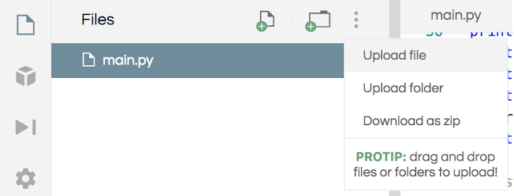
TESTING!
http://norvig.com/spell-testset1.txt
Download (save as text file using ctrl-s), upload into repl.it, make sure it’s named ‘spell-testset1.txt’
monitoring: monitering biscuits: biscits biscutes biscuts bisquits buiscits buiscuts available: avaible separate: seperate necessary: neccesary necesary neccesary necassary necassery neccasary definition: defenition receipt: receit receite reciet recipt remind: remine remined initials: inetials inistals initails initals intials
Notes:
Now that we have our algorithm, let’s test it out on some sample data! Go ahead and go to the norvig.com link and download that dataset. If you’re on repl.it, upload it into your project. If you’re offline, make sure it’s in the same folder as your code. Either way, name it spell-testset1.txt.
Open up the data file, and observe how it’s organized. Each line has one word, followed by a colon + space, followed by all of its possible common misspellings, each separated by a space. We’re going to use this structure to process our dataset.

Slide 28
LOADING TEST DATA
def testset(lines): return [(right, wrong) for (right, wrongs) in (line.split(':') for line in lines) for wrong in wrongs.split()]
List of tuples: (right, wrong), (right, wrong), etc
Example: initial: intial inetial would be separated into (initial, intial), (initial, inetial)
Notes:
The first thing we’ll do is load the data into a list of tuples of (right spelling, wrong spelling), (right spelling, wrong spelling), etc. To do this, we iterate through each line, splitting it by the : character, take the first part of the split as the right spelling, split the wrong spellings by the space, and then generate a tuple for each wrong spelling.

Slide 29
TEST FUNCTION
def spelltest(tests): good = 0 n = len(tests) for right, wrong in tests: w = correction(wrong) good += (w == right) print(str(good / n * 100) + '% of ' + str(n) + ' correct')
Notes:
Then, we’re going to actually write a function to test our algorithm, which, recall, is the correction function. The way we’ll do this is we’ll calculate our accuracy by keeping track of how many words the algorithm gets right over how many words we’re testing. So we’ll start a counter called good, and we’ll increment this every time we get something right. For simplicity, let’s call the number of test words n. Then, we’ll iterate through each right and wrong in tests, attempt to correct the wrong, and increment good if our correction matches the “right” word. Recall that booleans can also be forced into 0s or 1s, so w == right will be 1 if true, 0 if false. Finally, we’ll print out our accuracy using this string on the last line.

Slide 30
TESTING!
spelltest(testset(open('spell-testset1.txt')))
67.77777777777779% of 270 correct
Notes:
Basically run this and show the result, comment on how the result is pretty mediocre, and then maybe ask for some guesses on why the result isn’t super good

Slide 31
TESTING (BY US)
wrong_word = input('Type in a word!') while wrong_word != 'stop': print(correction(wrong_word)) wrong_word = input('Type in a word!')
Notes:
The other type of testing we want to do is individual words - sure, the accuracy is interesting for statistical purposes, but it would be nice if we could see exactly what our corrections are turning out to be. To do this, we’ll write a little user interface. First, we’re going to take the user’s input() for a wrong word that they want to correct, and then we’ll print the correction, and do this again and again until the user wants to stop, in which case they should input “stop” when prompted.

Slide 32
IMPROVEMENTS & EXTENSIONS
Context: words like “stanp” and “form”
Grammar: words like “everyday”
Different dialects: words like “colour”
Greater edit distance: words like “orinj”
Potential fixes: more data
Web mining, other NLTK corpuses, expand Gutenberg
Different tokenizers
N-grams
Extension: different languages
Notes:
Discuss some potential improvements to the algorithm
Context matters: stanp could be stand or stamp depending on the context, form could be from or norm etc
Sometimes things are English words, but they’re used incorrectly in a grammatical sense
Data is not 100% complete - might not capture different dialects of English, like British English or African American Vernacular English
We only go up to distance 2, but sometimes people spell words really wrongly, like orinj or quasont
How to fix: more data is good, also considering n-grams, which are n-word phrases, for context
We can also do this for different languages given the data

Slide 33
WRAP-UP
Code from today: https://tinyurl.com/linghacks-workshop-1
Notes:
Again, for consistency, please feel free to copy and paste the code into your own link and replace it on this slide.

